Slide 1

Dialysis Patience PPt

Slide 2

Group 4 1.Udhayasri 2.Prasanna 3.Chaithali 4.Yuvraj
Group – 4
Udhayasri Bandari
Mr.Prasanna Vilas Hedaoo
Ms Chaitali Suryabhan Gavhane
Mr. Yuvraj Uttamrao
sheetesh kumar singh
MR. DC . VINAY

Slide 3
Kpi’s explantation
Number of Patients across various summaries: We understanding of patient distribution across different categories.
Profit vs. Non-Profit Stats: The financial aspects and compare performance between profit and non-profit entities.
Chain Organizations w.r.t. Total Performance Score as No Score: The performance of chain organizations in relation to their total performance score.
Dialysis Stations Stats: In this we Analyze and visualize key metrics related to dialysis stations to identify trends and patterns.
5) # of Category Text – As Expected: The expected number of category texts and evaluate their impact on the overall dataset.
6) Average Payment Reduction Rate : In this we Calculate and track the average rate at which payments are reduced, providing insights into cost-saving measures.

Slide 4
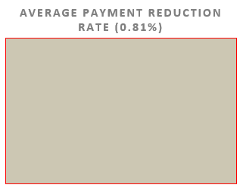
Dialysis Patience Excel dashboard

Slide 5
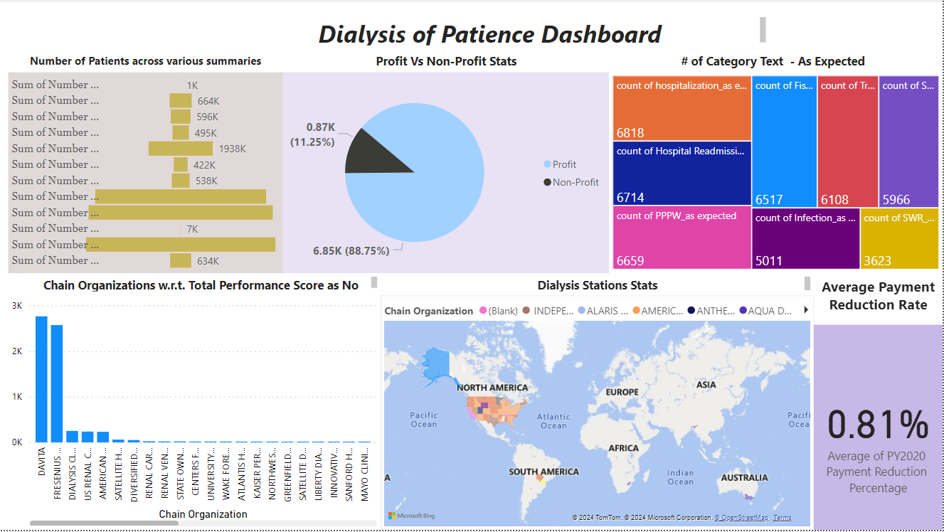

Slide 6
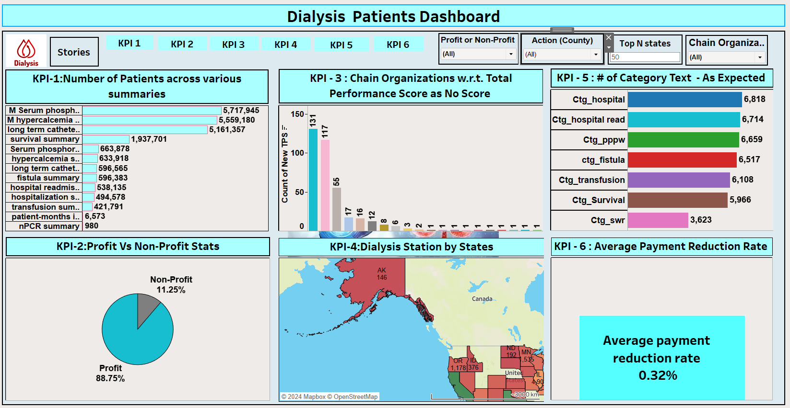

Slide 7
SUGGESTIONS
Focus on optimizing services for survival summary, given the highest number of patients in this category.
Continue optimizing profit-generating aspects, as they constitute the majority (88.75%) of patients.
Investigate and address performance issues in ‘Fresenius medical care’ and ‘Davita’ chain organizations.
Optimize resource allocation and services for Davita, as it has the highest number of dialysis stations in terms of profit.
Regularly monitor and manage the average payment reduction rate to ensure financial sustainability.

Slide 8
Conclusion
In summary, a comprehensive strategy that includes optimizing services for all patient summaries, addressing performance issues in specific chain organizations, and maximizing the potential of dialysis stations for both profit and non-profit segments will contribute to the overall success of the healthcare organization.

Slide 9

Thank you

